Slide 2
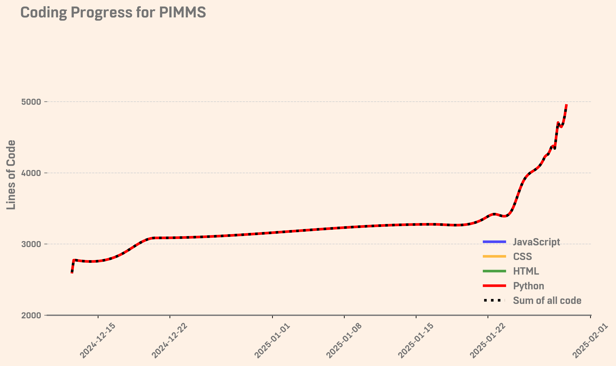
All filtering steps done
Patent meeting

Slide 3
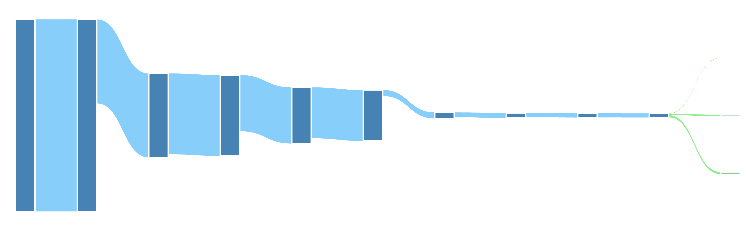

PIMMS v1.2 – a fully self-contained software
Blank Subtraction
RT, m/z, Intensity
Smearing
Branching/similarity
Monoisotopic filter
Likely
ML
Detection frequency
Mass defect
Standard mix
Tentative (EPA match)
336
271
233
227
3099
2808
Tentative (no EPA match)
4628
4456
12572
Features
10577

